Slide 1

准备好导练册
Sharing makes growth more powerful
定语从句
Attributive Clause
Attributive Clause

Slide 2
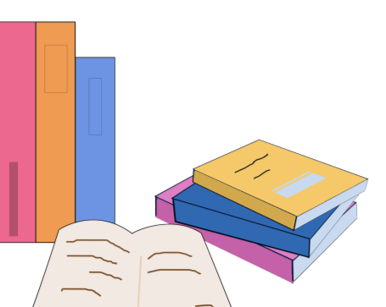
题型一考察从句中的先行词、关系词和关系词在句中承担的成分
关系词
先行词
承担成分
W:who which whom whose
T:that
看见别犹豫
必是关系词
大多数是关系词前的名词或代词
PS:代词就是他她它一类
大部分作
主语和宾语
主语:
从句动词和关系词中间没有他她它
宾语:反之

Slide 3
题型一考察从句中的先行词、关系词和关系词在句中承担的成分
Have a try
Page 76
1.Mary likes music that is quiet and gentle.
2.The coat that I put on the desk is blue.
3.The building which stands near the train station is a supermarket.
4.The film which we saw last night was wonderful.
5.The girl who often helps me with my English is from England.

Slide 4


题型二考察从句的拆分和合并
分句子做题方法：分割法
1
第一分分在关系词之前（前面的句子成分记作Part1）
2
第二分分在主句动词前（后面的句子成分记作Part3）
Page 79 Part 3
3
将part3与part1结合
The boys /who are playing football /are from class one.
The boys are from class one, they are playing football.
4
关系词改为主和宾
He/She/It
him/her/it

Slide 5
题型二考察从句的拆分和合并
指代同一物体的词语
和句子做题方法：口诀法
Page 83 Part 3
先寻重复词，定为先行词。
再看成分细，主宾要辨晰。
关系词代换，紧跟先行毗。
多余部分弃，两句并成一。
The Nail is a river, it used to floot every year. The Nail is a river which/that used to floot every year

Slide 6
题型三考察关系词只能用that的情况（难点）
Page 89 Part 3
a. 先行词前为序数词和最高级，本身是数词和最高级时
He was the first person that passed the exam.
b. 先行词为 all, any, much, many, everything, none, the one 等不定代词时
如：Is there anything that you want to buy in the shop?
c. 先行词被 the only/very/same/last, little, few 等词修饰时
d. 先行词里同时含有人和物时
例如：I can remember well the persons and some pictures that I saw in the room.
e. 以 who 或 which 引导的疑问句
例如：Who is the girl that is crying?
f. 主句是 there be 结构
例如：There is a book on the desk that belongs to Tom.

Slide 7

题型四考察谓语动词的单复数
Key Points
当关系词充当定语从句的主语时，从句谓语动词的单复数与先行词保持一致
Page 92 练习

